Slide 1
ADO.NET

Slide 2
What is ADO.NET?
ADO.NET is the new database technology of the .NET (Dot Net) platform, and it builds on Microsoft ActiveX® Data Objects (ADO).
ADO is a language-neutral object model that is the keystone of Microsoft's Universal Data Access strategy.
ADO.NET is an integral part of the .NET Compact Framework, providing access to relational data, XML documents, and application data. ADO.NET supports a variety of development needs. You can create database-client applications and middle-tier business objects used by applications, tools, languages or Internet browsers.

Slide 3
ADO.NET provides data access services in the Microsoft .NET platform.
You can use ADO.NET to access data by using the new .NET Framework data providers which are:
Data Provider for SQL Server (System.Data.SqlClient).
Data Provider for OLEDB (System.Data.OleDb).
Data Provider for ODBC (System.Data.Odbc).
Data Provider for Oracle (System.Data.OracleClient).
ADO.NET is a set of classes that expose data access services to the .NET developer. The ADO.NET classes are found in System.Data.dll and are integrated with the XML classes in System.Xml.dll.
There are two central components of ADO.NET classes: the DataSet, and the .NET Framework Data Provider.

Slide 4
Data Provider is a set of components including:
the Connection object (SqlConnection, OleDbConnection, OdbcConnection, OracleConnection)
the Command object (SqlCommand, OleDbCommand, OdbcCommand, OracleCommand)
the DataReader object (SqlDataReader, OleDbDataReader, OdbcDataReader, OracleDataReader)
and the DataAdapter object (SqlDataAdapter, OleDbDataAdapter, OdbcDataAdapter, OracleDataAdapter).
DataSet object represents a disconnected cache of data which is made up of DataTables and DataRelations that represent the result of the command.

Slide 5
ADO.Net Object Model / ADO.NET architecture
ADO.Net object model is nothing but the structured process flow through various components. The object model can be pictorially described as:

Slide 6
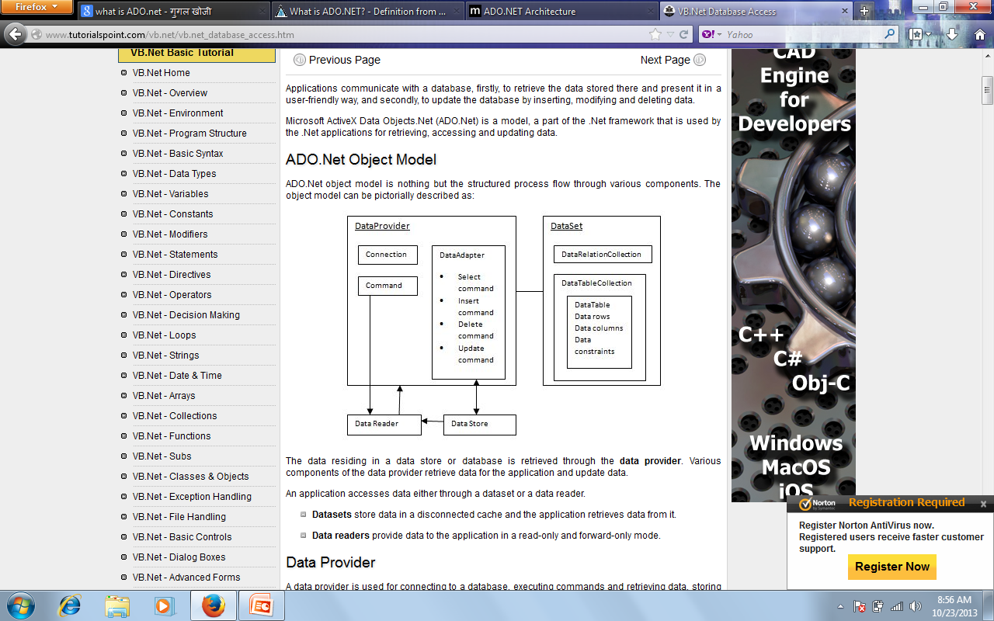

Slide 7
DataAdapter: This class acts as bridge between the databases and the copy of the database in the memory.Fill method is used to populate the datatset or datatable with data from the database.Update method is used to update the database after the dataset is manipulated.
DataReader This class acts as a read only or forward only action to fetch data from a database.ExecuteReader method is used to returns the object of this class.

Slide 8
DataSet This class stores the copy of the database retreived from the original.

Slide 9
Data Provider
A data provider is used for connecting to a database, executing commands and retrieving data, storing it in a dataset, reading the retrieved data and updating the database.
The data provider in ADO.Net consists of the following four objects:

Slide 10
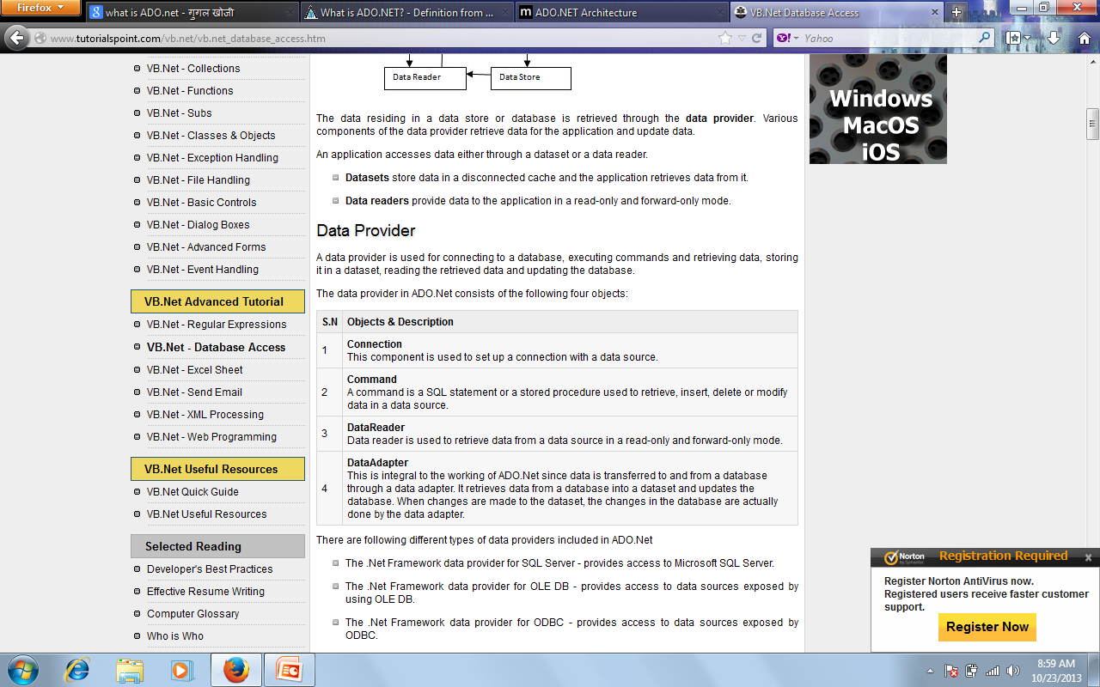

Slide 11
There are following different types of data providers included in ADO.Net
The .Net Framework data provider for SQL Server - provides access to Microsoft SQL Server.
The .Net Framework data provider for OLE DB - provides access to data sources exposed by using OLE DB.
The .Net Framework data provider for ODBC - provides access to data sources exposed by ODBC.
The .Net Framework data provider for Oracle - provides access to Oracle data source.
The EntityClient provider - enables accessing data through Entity Data Model (EDM) applications.

Slide 12
DataSet
DataSet is an in-memory representation of data. It is a disconnected, cached set of records that are retrieved from a database. When a connection is established with the database, the data adapter creates a dataset and stores data in it. After the data is retrieved and stored in a dataset, the connection with the database is closed. This is called the 'disconnected architecture'. The dataset works as a virtual database containing tables, rows, and columns.
The following diagram shows the dataset object model:

Slide 13
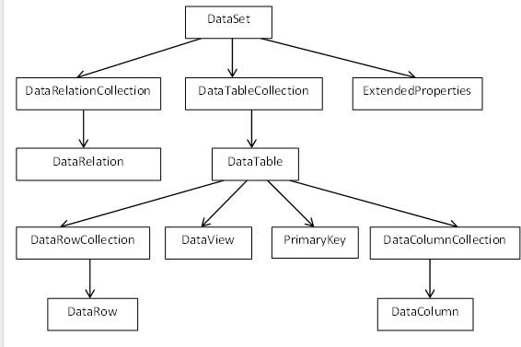

Slide 14
The DataSet class is present in the System.Data namespace. The following table describes all the components of DataSet:

Slide 15
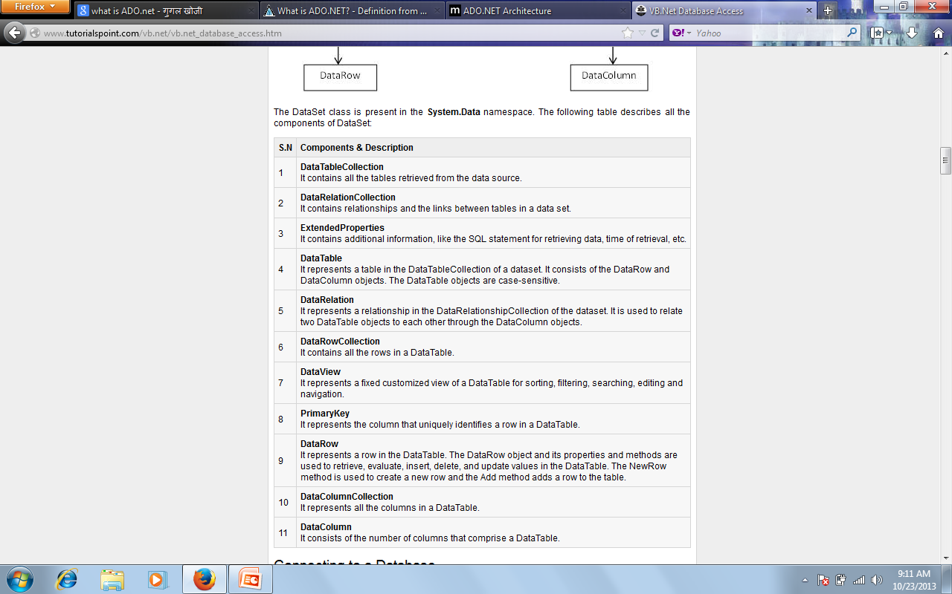

Slide 16
What is DataAdapter
DataAdapter is a part of the ADO.NET Data Provider. DataAdapter provides the communication between the Dataset and the Datasource. We can use the DataAdapter in combination with the DataSet Object. That is these two objects combine to enable both data access and data manipulation capabilities.

Slide 17
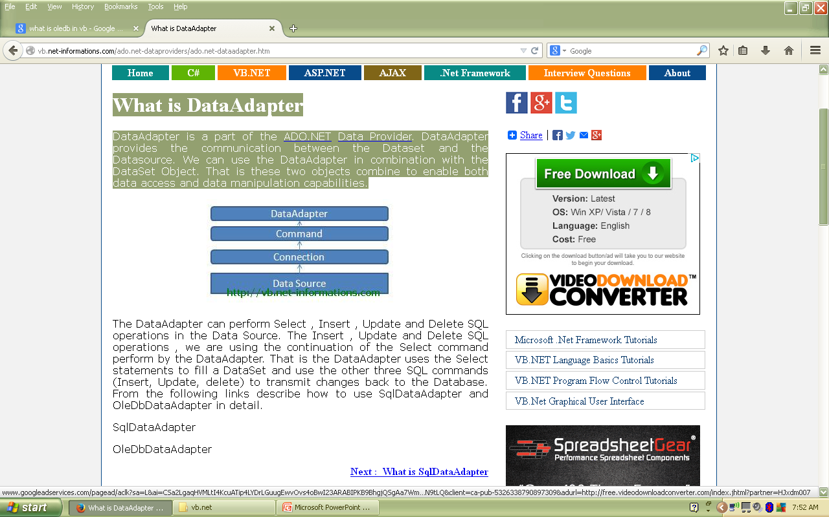

Slide 18
The DataAdapter can perform Select , Insert , Update and Delete SQL operations in the Data Source. The Insert , Update and Delete SQL operations , we are using the continuation of the Select command perform by the DataAdapter. That is the DataAdapter uses the Select statements to fill a DataSet and use the other three SQL commands (Insert, Update, delete) to transmit changes back to the Database. From the following links describe how to use SqlDataAdapter and OleDbDataAdapter in detail.
SqlDataAdapter
OleDbDataAdapter

Slide 19
What is SqlDataAdapter
SqlDataAdapter is a part of the ADO.NET Data Provider and it resides in the System.Data.SqlClient namespace. SqlDataAdapter provides the communication between the Dataset and the SQL database. We can use SqlDataAdapter Object in combination with Dataset Object.
Dim adapter As New SqlDataAdapter
The SqlDataAdapter Object and DataSet objects are combine to perform both data access and data manipulation operations in the SQL Server Database. When the user perform the SQL operations like Select , Insert etc. in the data containing in the Dataset Object , it won't directly affect the Database, until the user invoke the Update method in the SqlDataAdapter.

Slide 20
Imports System.Data.SqlClient
Public Class Form1 Private Sub Button1_Click(ByVal sender As System.Object, ByVal e As System.EventArgs) Handles Button1.Click
Dim connetionString As String
Dim sqlCnn As SqlConnection
Dim sqlCmd As SqlCommand
Dim adapter As New SqlDataAdapter
Dim ds As New DataSet
Dim i As Integer
Dim sql As String
connetionString = "Data Source=ServerName;Initial Catalog=DatabaseName;User ID=UserNamePassword=Password"
sql = "Select * from product“
sqlCnn = New SqlConnection(connetionString)
Try
sqlCnn.Open()

Slide 21
sqlCmd = New SqlCommand(sql, sqlCnn)
adapter.SelectCommand = sqlCmd adapter.Fill(ds)
For i = 0 To ds.Tables(0).Rows.Count – 1
MsgBox(ds.Tables(0).Rows(i).Item(0) & " -- " & ds.Tables(0).Rows(i).Item(1))
Next
adapter.Dispose()
sqlCmd.Dispose()
sqlCnn.Close()
Catch ex As Exception
MsgBox("Can not open connection ! ")
End Try
End Sub
End Class

Slide 22
connetionString = "Data Source=ServerName;Initial Catalog=DatabaseName;User ID=UserName;Password=Password" sql = "Select * from product" You have to replace the string with your realtime variables.

Slide 23
What is OleDbDataAdapter
OleDbDataAdapter is a part of the ADO.NET Data Provider and it resides in the System.Data.OleDb namespace. OleDbDataAdapter provides the communication between the Dataset and the OleDb Data Sources. We can use OleDbDataAdapter Object in combination with Dataset Object.
The OleDbDataAdapter Object and DataSet objects are combine to perform both Data Access and Data Manipulation operations in the OleDb Data Sources. When the user perform the SQL operations like Select , Insert etc. in the data containing in the Dataset Object , it won't directly affect the Database, until the user invoke the Update method in the OleDbDataAdapter.

Slide 24
Imports System.Data.OleDb
Public Class Form1 Private Sub Button1_Click(ByVal sender As System.Object, ByVal e As System.EventArgs) Handles Button1.Click Dim connetionString As String
Dim oledbCnn As OleDbConnection
Dim oledbAdapter As OleDbDataAdapter
Dim ds As New DataSet
Dim sql As String
Dim i As Integer
connetionString = "Provider=Microsoft.Jet.OLEDB.4.0;Data Source=Your mdb filename;"
sql = "Your SQL Statement Here like Select * from product“
oledbCnn = New OleDbConnection(connetionString)
Try
oledbCnn.Open()

Slide 25
oledbAdapter = New OleDbDataAdapter(sql, oledbCnn)
oledbAdapter.Fill(ds)
For i = 0 To ds.Tables(0).Rows.Count - 1
MsgBox(ds.Tables(0).Rows(i).Item(0) & " -- " & ds.Tables(0).Rows(i).Item(1))
Next oledbAdapter.Dispose()
oledbCnn.Close()
Catch ex As Exception
MsgBox("Can not open connection ! ")
End Try
End Sub
End Class

Slide 26
connetionString = "Provider=Microsoft.Jet.OLEDB.4.0;Data Source=Your mdb filename;" sql = "Your SQL Statement Here like Select * from product" You have to replace the string with your realtime variables.

Slide 27
Connecting to a Database
The .Net Framework provides two types of Connection classes:
SqlConnection - designed for connecting to Microsoft SQL Server.
OleDbConnection - designed for connecting to a wide range of databases, like Microsoft Access and Oracle.

Slide 28
ADO.NET OLEDB Connection
An instance of the OleDbConnection class in .NET Framework is supported the OLEDB Data Provider. The OleDbConnection instance takes Connection String as argument and pass the value to the Constructor statement. When the connection is established , SQL Commands may be executed, with the help of the Connection Object, to retrieve or manipulate data in the database.
Once the Database activities over , Connection should be closed and release the resources . The Close() method in SqlConnection class is used to close the Database Connection. The Close method rolls back any pending transactions and releases the Connection from the Database connected by the OLEDB Data Provider.

Slide 29
Imports System.Data.OleDb Public Class Form1 Private Sub Button1_Click(ByVal sender As System.Object, ByVal e As System.EventArgs) Handles Button1.Click
Dim connetionString As String
Dim cnn As OleDbConnection
connetionString = "Provider=Microsoft.Jet.OLEDB.4.0;Data Source=yourdatabasename.mdb;"
cnn = New OleDbConnection(connetionString)
Try
cnn.Open() MsgBox("Connection Open ! ")
cnn.Close()
Catch ex As Exception
MsgBox("Can not open connection ! ")
End Try
End Sub
End Class

Slide 30
ADO.NET ODBC Connection
An instance of the OdbcConnection class in .NET Framework is supported the ODBC Data Provider. The OdbcConnection instance takes Connection String as argument and pass the value to the Constructor statement. When the connection is established , SQL Commands may be executed, with the help of the Connection Object, to retrieve or manipulate data in the database.
Once the Database activities over , Connection should be closed and release the resources . The Close() method in SqlConnection class is used to close the Database Connection. The Close method rolls back any pending transactions and releases the Connection from the Database connected by the ODBC Data Provider.

Slide 31
Imports System.Data.Odbc
Public Class Form1 Private Sub Button1_Click(ByVal sender As System.Object, ByVal e As System.EventArgs) Handles Button1.Click
Dim connetionString As String
Dim cnn As OdbcConnection connetionString = "Driver={Microsoft Access Driver (*.mdb)};DBQ=yourdatabasename.mdb;"
cnn = New OdbcConnection(connetionString)
Try
cnn.Open()
MsgBox("Connection Open ! ")
cnn.Close()
Catch ex As Exception MsgBox("Can not open connection ! ") End Try
End Sub
End Class

Slide 32
You have to provide the necessary informations to the Connection String. connetionString = "Driver = {Microsoft Access Driver (*.mdb)}; DBQ = yourdatabasename.mdb;"

Slide 33
ADO.NET Command
The Command Object in ADO.NET executes SQL statements and Stored Procedures against the data source specified in the Connection Object. The Command Object required an instance of a Connection Object for executing the SQL statements. That is, for retrieving data or execute an SQL statement against a Data Source , you have to create a Connection Object and open a connection to the Data Source, and assign the open connection to the connection property of the Command Object. When the Command Object return result set , a Data Reader is used to retrieve the result set.

Slide 34
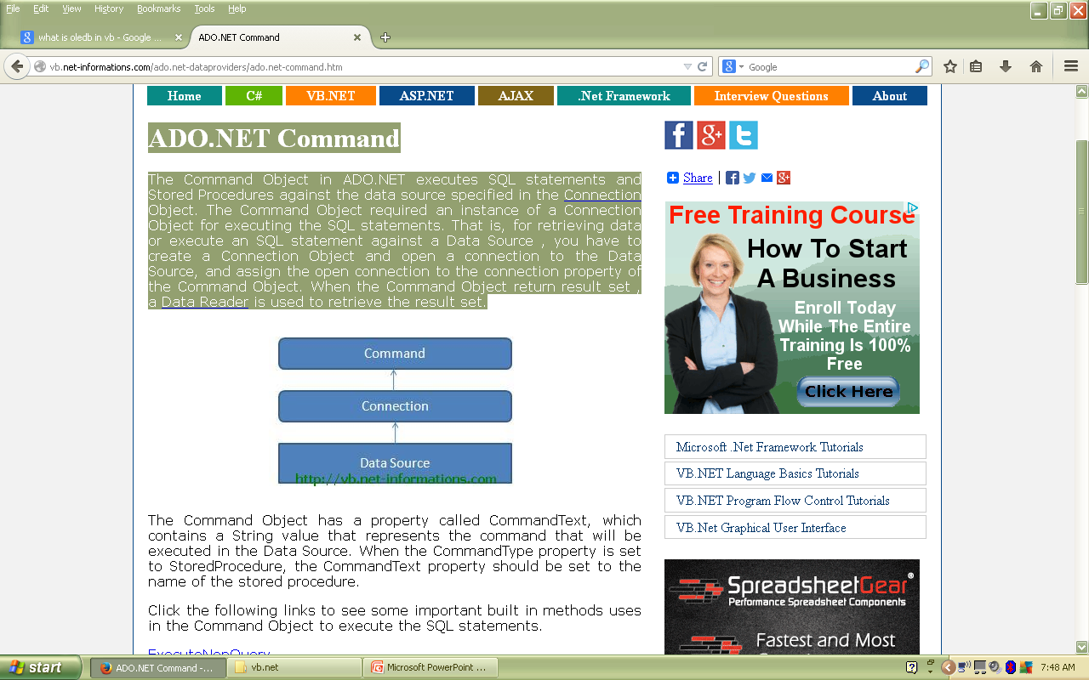

Slide 35
Example 1
We have a table stored in Microsoft SQL Server, named Customers, in a database named testDB.
Let us connect to this database. Take the following steps:

Slide 36
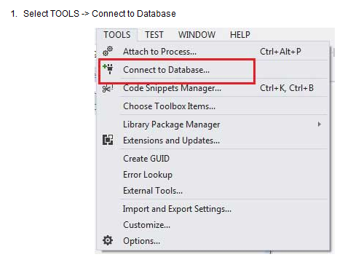
2

Slide 37
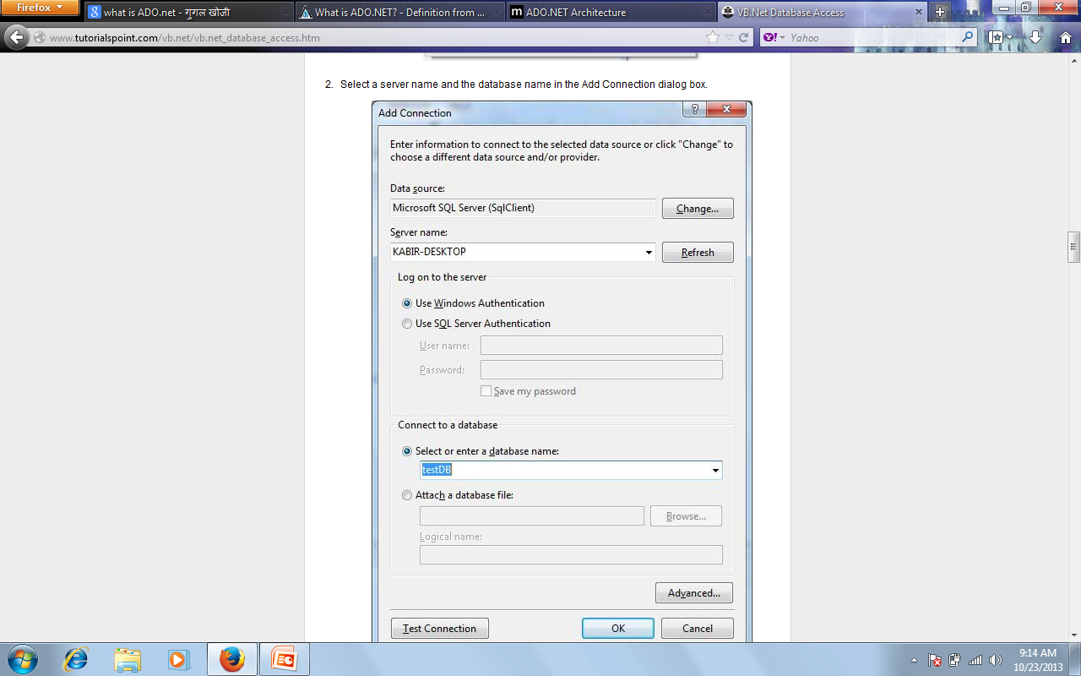

Slide 38
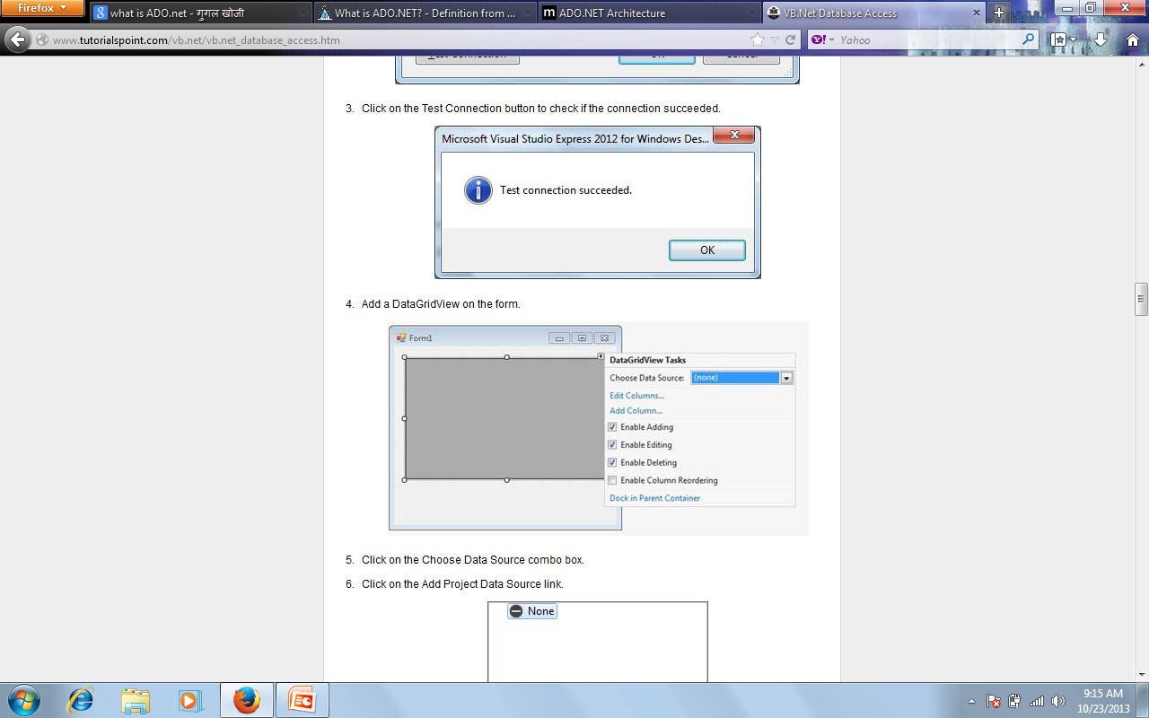

Slide 39
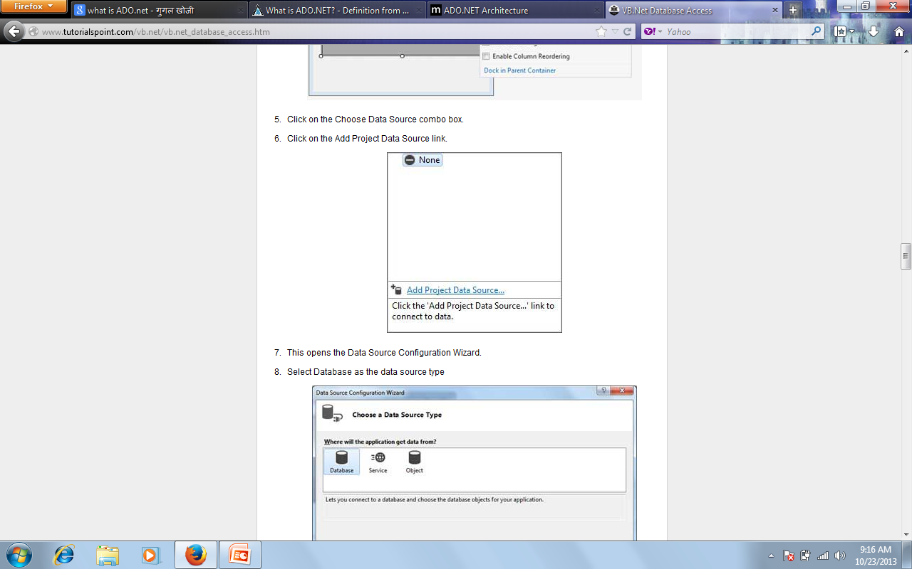

Slide 40
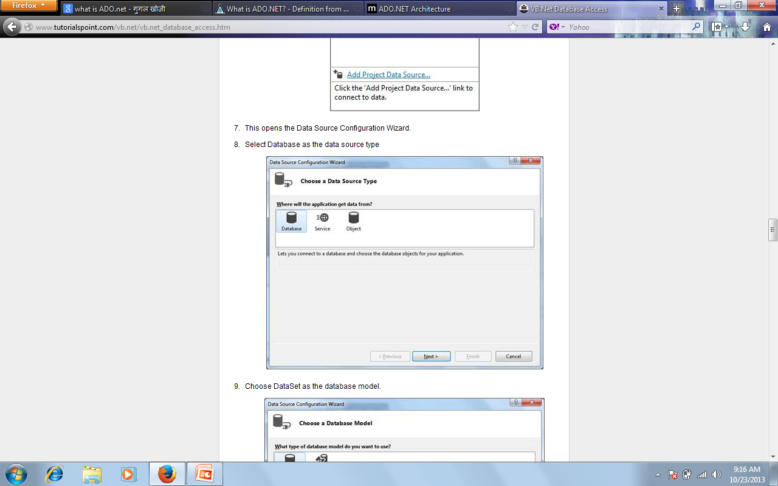

Slide 41
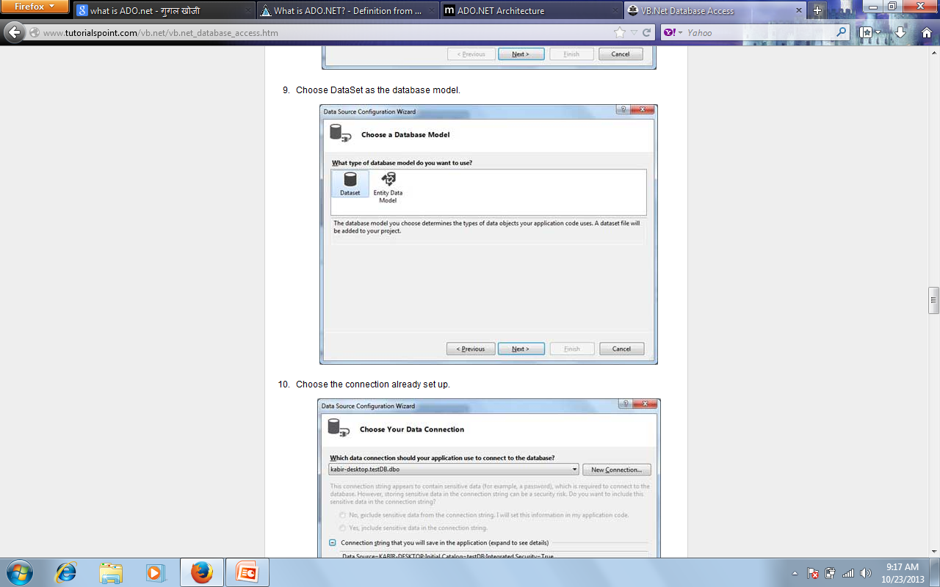

Slide 42
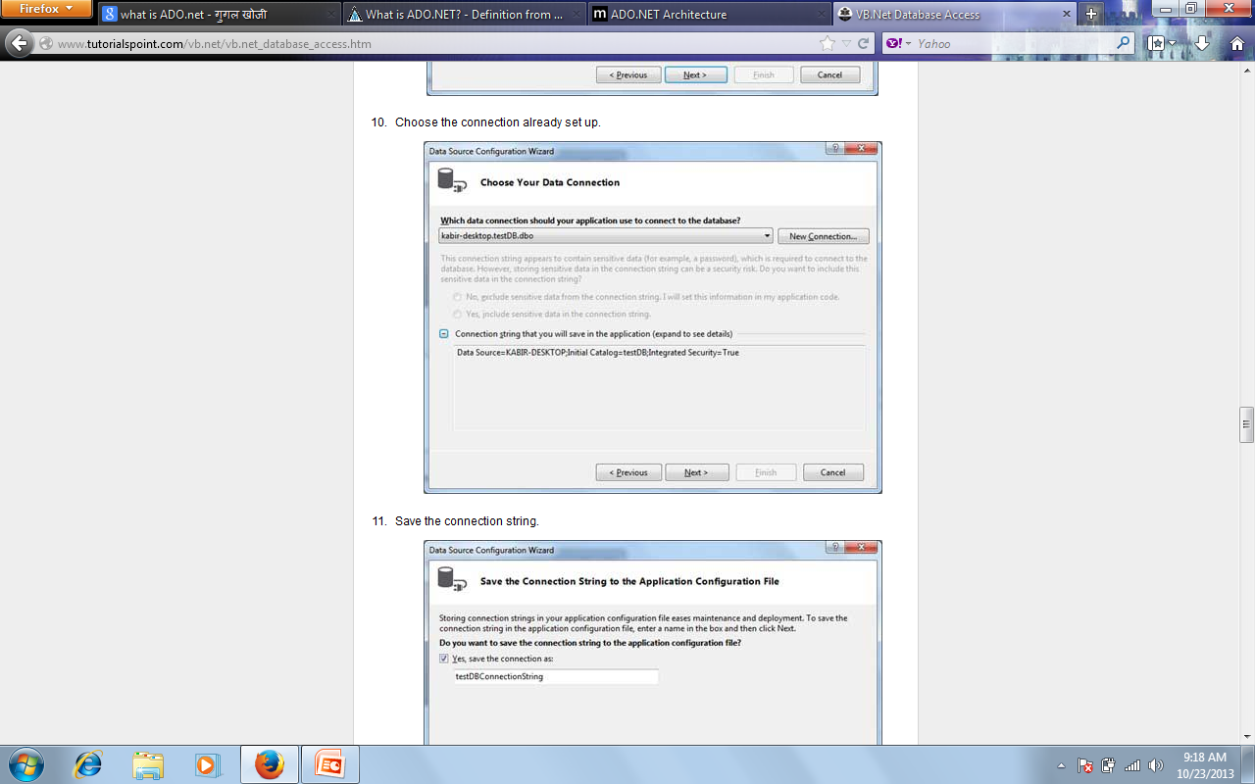

Slide 43
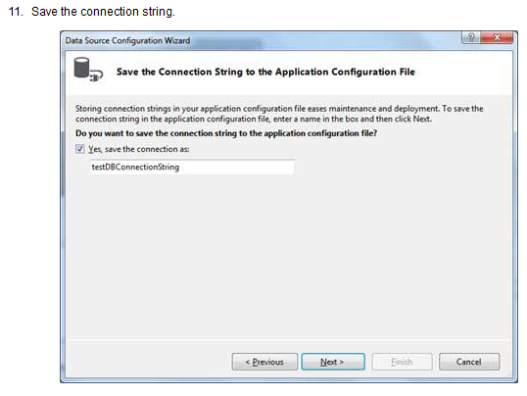

Slide 44
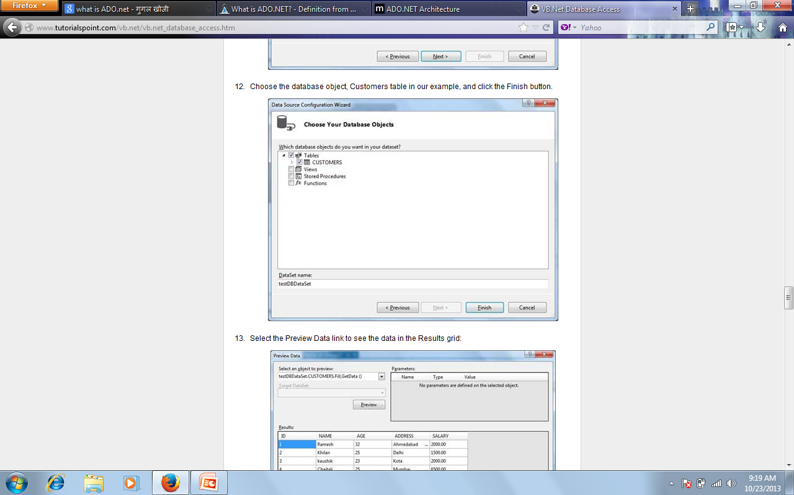

Slide 45
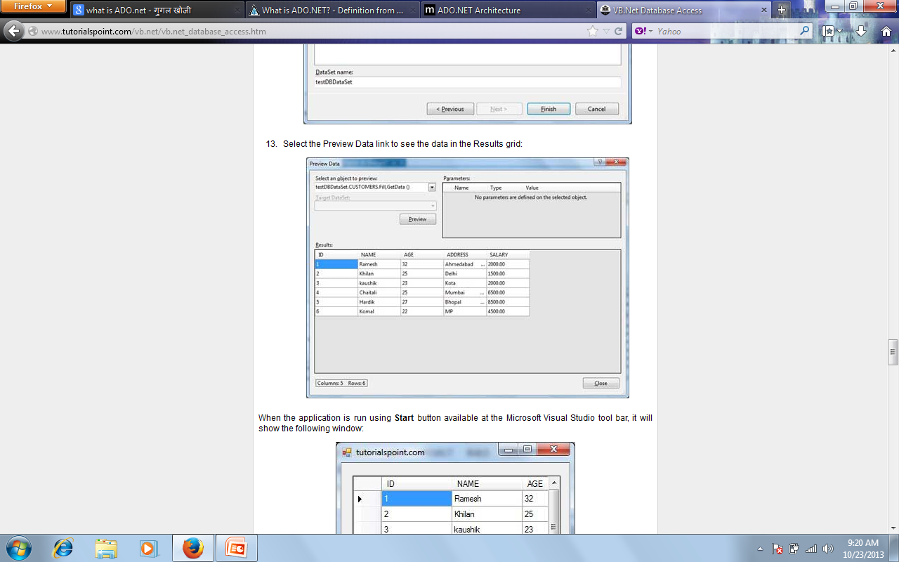

Slide 46
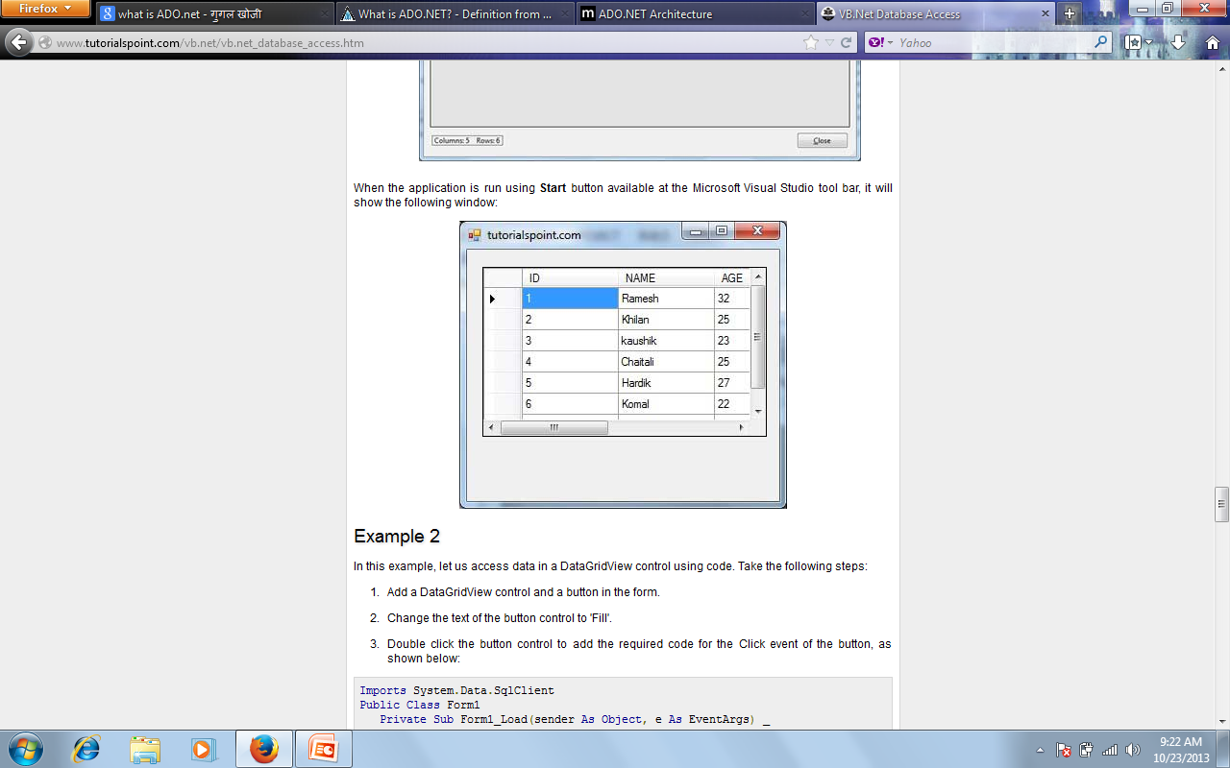

Slide 47
Example 2
In this example, let us access data in a DataGridView control using code. Take the following steps:
Add a DataGridView control and a button in the form.
Change the text of the button control to 'Fill'.
Double click the button control to add the required code for the Click event of the button, as shown below

Slide 48
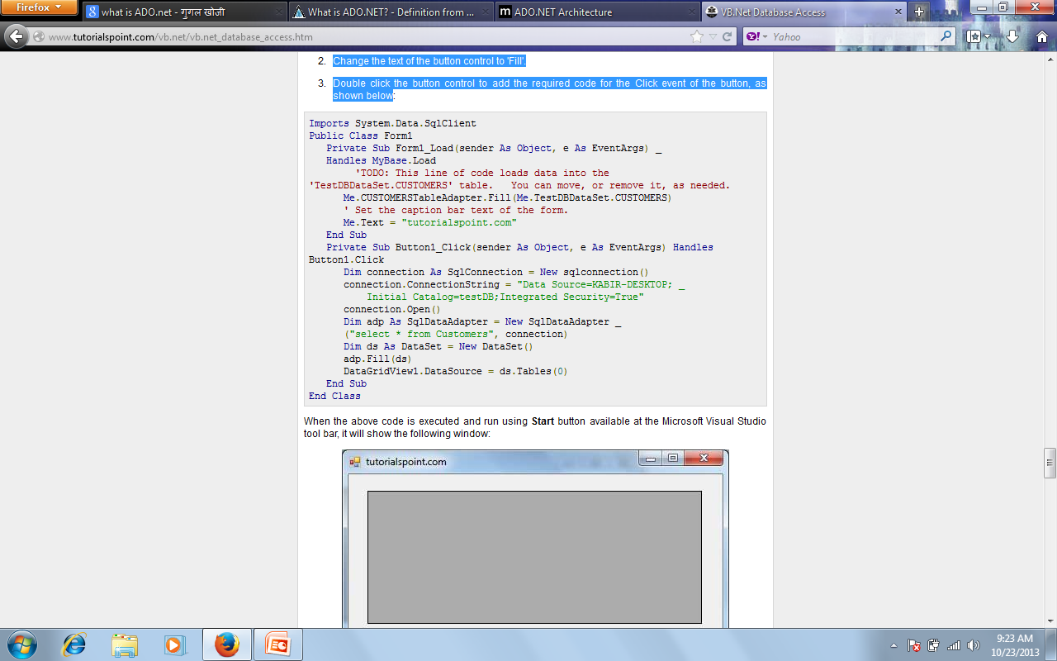

Slide 49
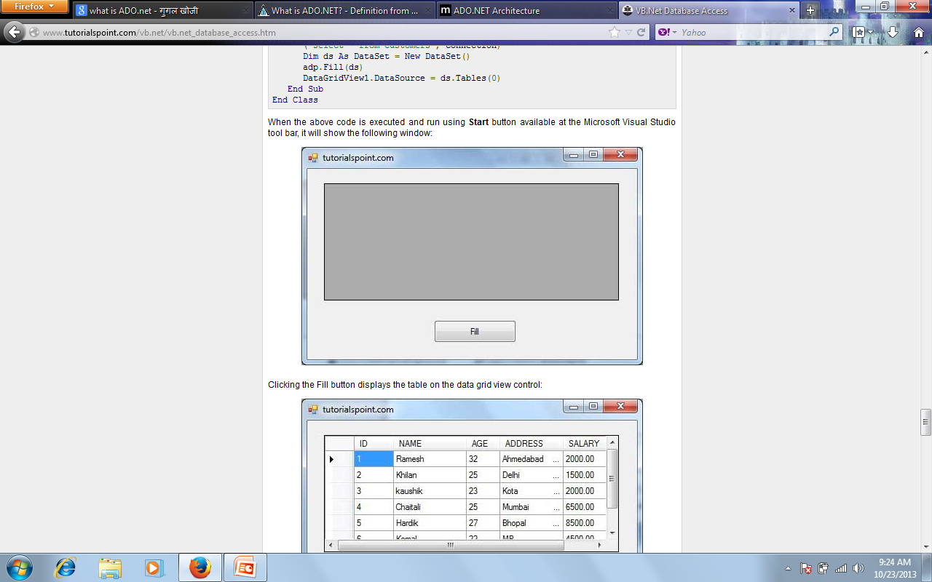

Slide 50
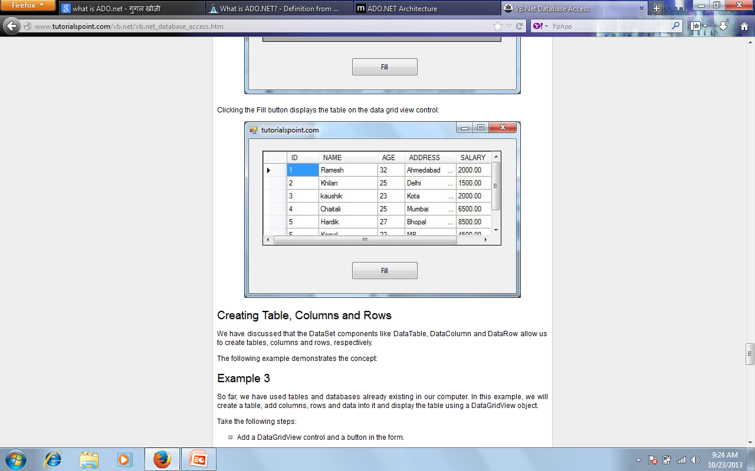

Slide 51
Creating Table, Columns and Rows
We have discussed that the DataSet components like DataTable, DataColumn and DataRow allow us to create tables, columns and rows, respectively.
The following example demonstrates the concept:
Example 3
So far, we have used tables and databases already existing in our computer. In this example, we will create a table, add columns, rows and data into it and display the table using a DataGridView object.
Take the following steps:
Add a DataGridView control and a button in the form.
Change the text of the button control to 'Fill'.
Add the following code in the code editor.

Slide 52
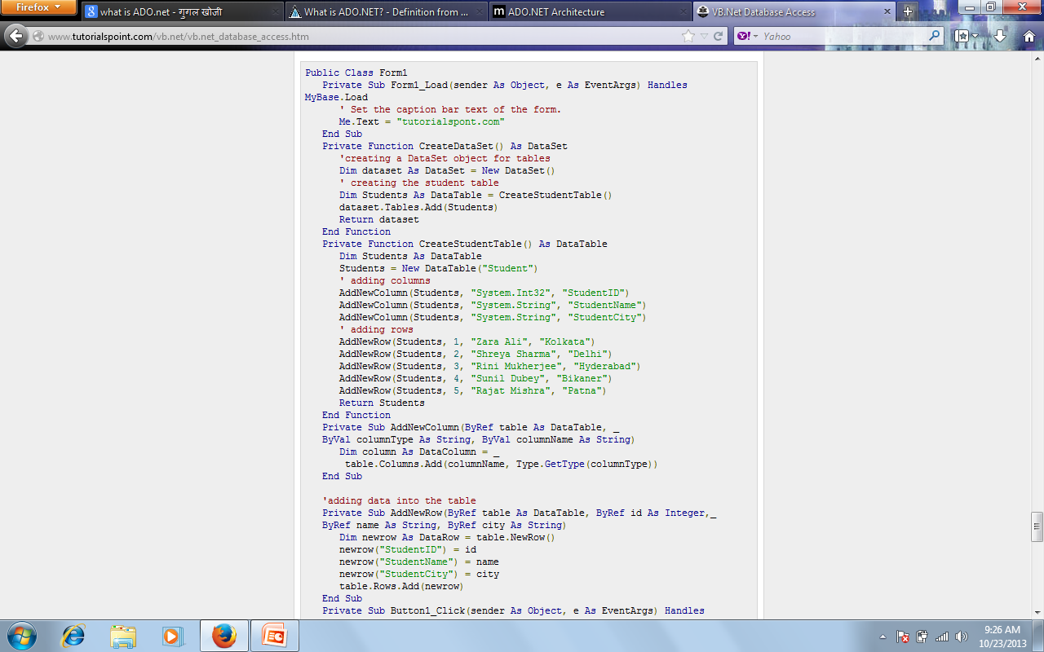

Slide 53
